Slide 1
OPPOSITES
TOP
UP
TRUE
IN
BOTTOM
DOWN
FALSE
OUT
Notes:
TYPICAL OPPOSITES. OPPOSITES ATTRACT? SOMETIMES THIS ATTRACTION IS MORE LIKE A COLLISION!

Slide 2
OPPOSITES
FAITH
GRACE
SPIRIT
WORKS
LAW (MOSAIC)
FLESH
Notes:
NOT COLLISIONS AT ALL, RATHER COMPLIMENTARY IF PROPERLY UNDERSTOOD.

Slide 3
Ephesians 2:8–9 (NKJV)
⁸ For by grace you have been saved through faith, and that not of yourselves; it is the gift of God, ⁹ not of works, lest anyone should boast.
Notes:
THE BIBLE SAYS VERY CLEARLY, WE ARE SAVED BY GRACE THROUGH FAITH. THIS WAS THE BATTLE CRY OF THE REFORMERS FROM HUS, TO LUTHER, TO CALVIN. STICK TO IT. BUT POINT OUT VERSE 10. WE NEVER WANT TO DEEMPHASIS THE IMPORTANCE OF WORKS. WE BELIEVERS ARE GOING TO BE JUDGED FOR WOUR WORKS, NOT OUR SIN WHICH WAS JUDGED ON THE CROSS.

Slide 4
Ephesians 2:8–10 (NASB95)
8 For by grace you have been saved through faith; and that not of yourselves, it is the gift of God;
9 not as a result of works, so that no one may boast.
10 For we are His workmanship, created in Christ Jesus for good works, which God prepared beforehand so that we would walk in them.
Notes:
WORKS ARE NEVER PRESENTED IN SCRIPTURE AS “OPTIONAL”. DO THEM OR DON’T, IT DOESN’T MATTER. IT MATTERS! JUDGEMENT SEAT OF CHRIST

Slide 5
IT IS NOT FAITH OR WORKS
IT IS FAITH AND WORKS BUT WITH AN ACCURATE UNDERTANDING OF THE PART BOTH PLAY IN LIVING THE CHRISTIAN LIFE
Notes:
FREQUENTLY IT TAKES A LOT OF PRETTY DEEP STUDY TO UNDERSTAND HOW THESE “OPPOSITES” CAN BE RECONCILED. NOT A COLLISION.

Slide 6
OPPOSITES
FLESH (CARNAL)
THE BODY, SOUL, AND SPIRIT (HUMAN)OF MANKIND WITHOUT THE SPIRIT OF GOD. OUR THOUGHTS AND ACTIONS DONE ON OUR OWN
SPIRIT ----- THE HOLY SPIRIT OF GOD
Notes:
THESE ARE THE OPPOSITES I WANT US TO FOCUS ON TODAY. CARNAL REFERS TO OUR HUMANITY, OUR BEING HUMAN BEINGS, MEN AND WOMEM, CHILDREN AND ADULTS.

Slide 7
THE TEN COMMANDANTS ARE ABOUT REGULATING OR CONTROLING THE FLESH. I WILL EXPLAIN THAT MORE LATER
Notes:
THE SPIRIT OF GOD DOES NOT HAVE TO BE TOLD “DO NOT STEAL, MURDER, LUST, ETC. A TUTOR NOT A MEANS OF OBTAINING SALVATION. JEWISH MEMBER OF SUNDAY SCHOOL CLASS. EASIER TO BE SAVED IN OLD TESTAMENT TIMESXXXXXXXXXX

Slide 8
Romans 7:14–20 (NKJV)
¹⁴ For we know that the law is spiritual, but I am carnal, sold under sin. ¹⁵ For what I am doing, I do not understand. For what I will to do, that I do not practice; but what I hate, that I do. ¹⁶ If, then, I do what I will not to do, I agree with the law that it is good. ¹⁷ But now, it is no longer I who do it, but sin that dwells in me. ¹⁸ For I know that in me (that is, in my flesh) nothing good dwells; for to will is present with me, but how to perform what is good I do not find. ¹⁹ For the good that I will to do, I do not do; but the evil I will not to do, that I practice. ²⁰ Now if I do what I will not to do, it is no longer I who do it, but sin that dwells in me.
Notes:
WHAT IS PAUL SAYING. IS THE APOSTLE PAUL STILL HAVING TROUBLE WITH THE FLESH (CARNAL). THE SIN NATURE. MEMORY OF SINxxxxxx
BEFORE PAUL WAS SAVED. MUST IGNORE ALL PRINCIPLES OF BIBLICAL INTERPRETATION. SOME HAVE SAID THIS MAKES CHRISTIANS HAVE SOME KIND OF SPLIT PERSONALITY. WE DO IN A SENSE!!!

Slide 9
Romans 8:3–4 (NASB95)
3 For what the Law could not do, weak as it was through the flesh, God did: sending His own Son in the likeness of sinful flesh and as an offering for sin, He condemned sin in the flesh,
4 so that the requirement of the Law might be fulfilled in us, who do not walk according to the flesh but according to the Spirit.
Notes:
WHAT IS DETERMINING HOW WE “WALK” OR DETERMINES HOW WE LIVE OUR LIVES. ALWAYS A CHOICE.

Slide 10
Galatians 5:17 (NASB95)
17 For the flesh sets its desire against the Spirit, and the Spirit against the flesh; for these are in opposition to one another, so that you may not do the things that you please.
Notes:
THIS VERSE MAKES IT PLAIN THAT THE FLESH AND SPIRIT ARE OPPOSITES AND CANNOT BE MADE COMPATIBLE. WE HAVE THE SPIRIT OF GOD INDWELLING US TO EMPOWER US TO STAND AGAINST THE DESIRES OF THE FLESH. NOTICE, THE FLESH IS NOT GONE, ITS STILL THERE.

Slide 11
Romans 8:9 (NASB95)
9 However, you are not in the flesh but in the Spirit, if indeed the Spirit of God dwells in you. But if anyone does not have the Spirit of Christ, he does not belong to Him.
Notes:
THIS DOESN’T MEAN IF YOU ARE GIVING IN TO THE FLESH YOU ARE NOT SAVED. IT DOES MEAN THAT IF YOU ARE SAVED YOU HAVE THE POWER TO OVERCOME THE DESIRES OF THE FLESH. YOU HAVE NO EXCUSE!!!!!

Slide 12
1 Corinthians 3:1–3 (NASB95)
Foundations for Living
1 And I, brethren, could not speak to you as to spiritual men, but as to men of flesh, as to infants in Christ.
2 I gave you milk to drink, not solid food; for you were not yet able to receive it. Indeed, even now you are not yet able,
3 for you are still fleshly. For since there is jealousy and strife among you, are you not fleshly, and are you not walking like mere men?
Notes:
NOTICE, THEY ARE IN CHRIST, THEY JUST HAVE REFUSED TO GROW UP!!!!!! THEY ARE BEHAVING AS IF THEY WEREN’T EVEN SAVED. IF YOU AREN’T UNDERSTANDING DEAN’S SERMONS YOU NEED TO BE STUDYING THE BIBLE MORE. BE IN BIBLE STUDIES. GET A GOOD STUDY BIBLE TO HELP.

Slide 13
Romans 8:13 (NASB95)
13 for if you are living according to the flesh, you must die; but if by the Spirit you are putting to death the deeds of the body, you will live.
Notes:
WHAT IN THE WORLD DOE THIS MEAN?? WHAT DIES AN WHAT DOESN’T? THE SPIRIT WILL LIVE, THE FLESH WILL DIE.
THE FLESH IS NOT ETERNAL. DEATH=SEPARATION. “LIVE” FREQUENTLY REFERS TO LIVING A FULL, FRUITHFUL LIFE THAT WILL BE REWARDED AND WILL CONTINUE INTO ETERNITY.

Slide 14
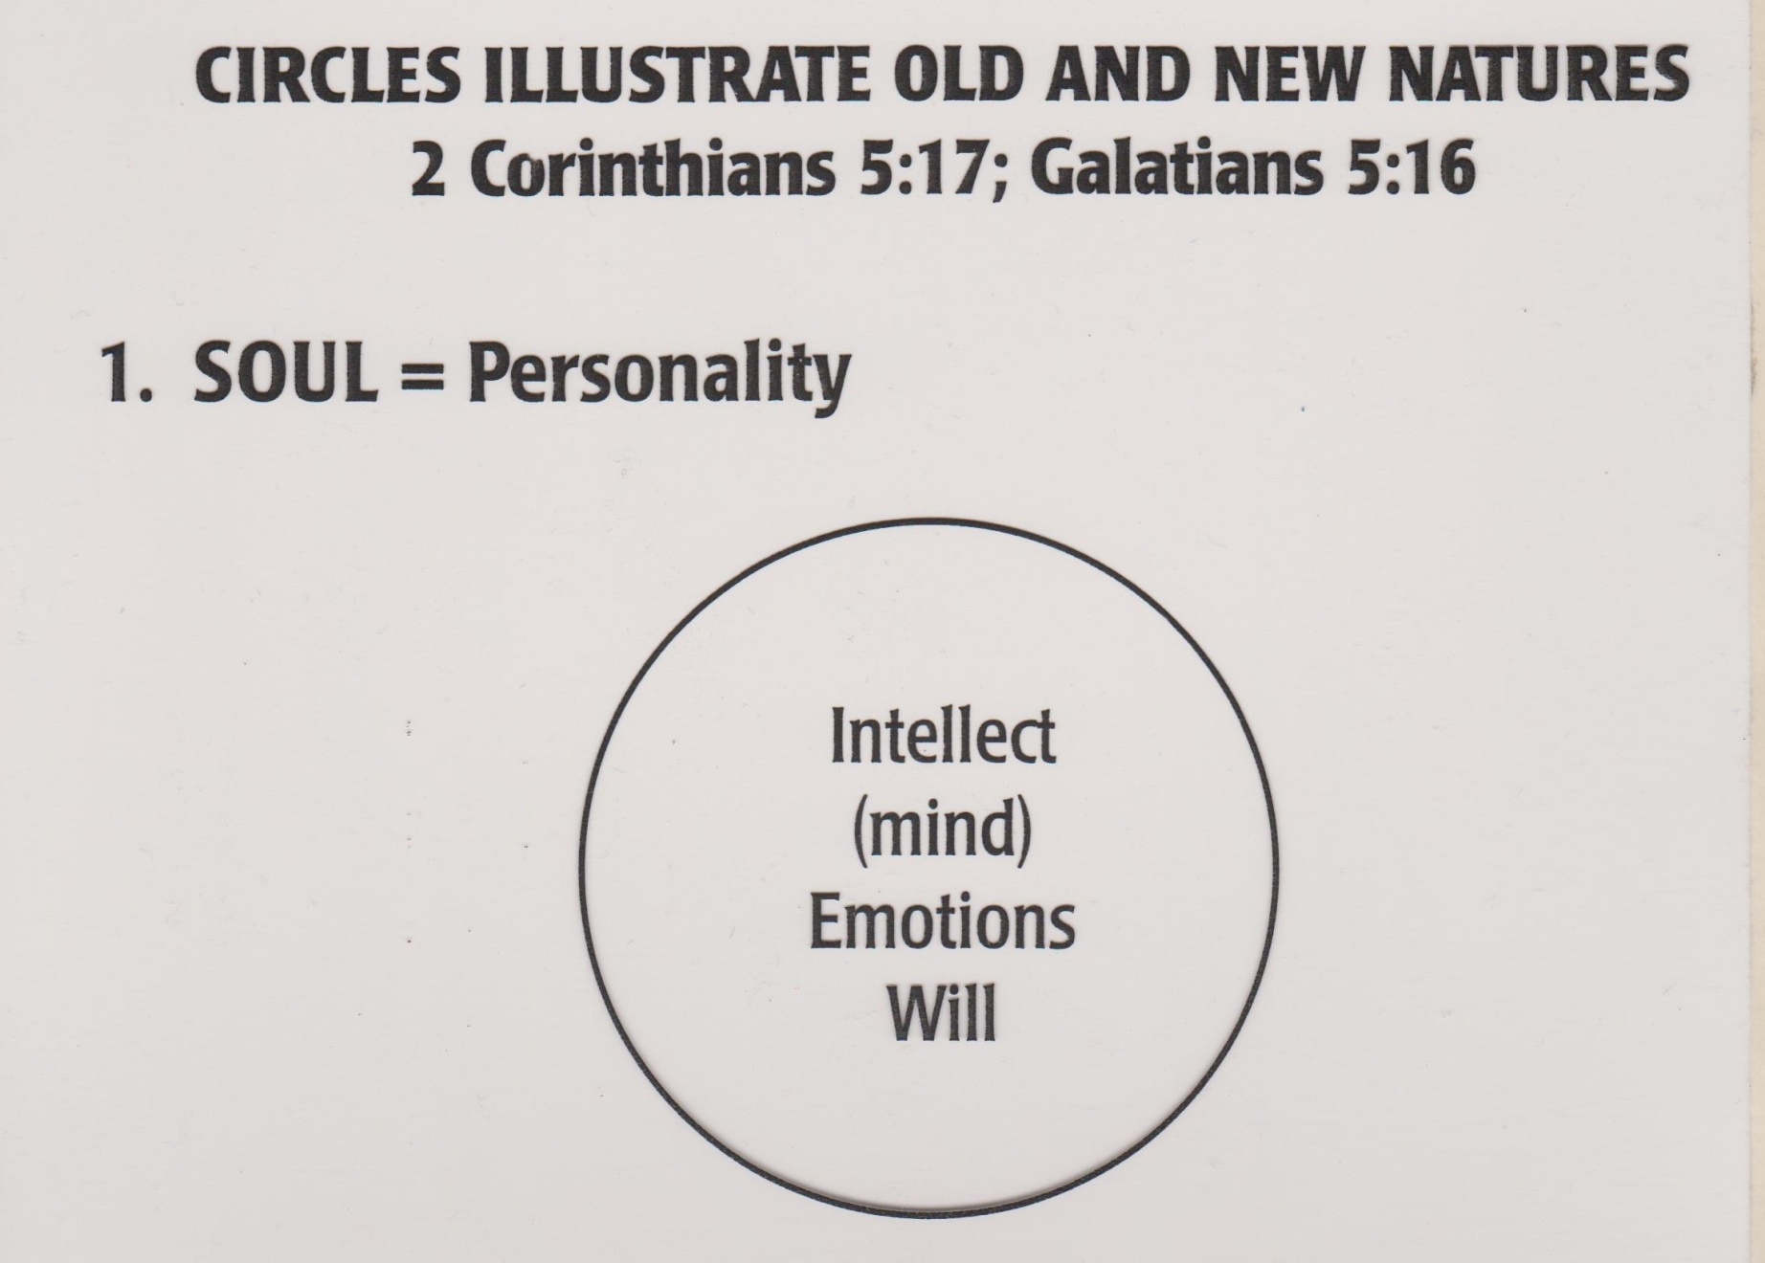
Notes:
ONLY ADAM AND JESUS CHRIST WERE BORN IN THIS CONDITION. SINLESS. I WOULD ADD BODY, SOUL, AND SPIRIT. HUMAN SPIRIT. MANKIND IN IT’S TOTALITY.

Slide 15
Notes:
IN THE GARDEN BECAUSE OF SIN TOWARD GOD, CHOSING TO GO HIS OWN WAY AND FOLLOW HIS OWN RULES MANKING FIRST “SPIRITUALLY”, IE, SEPARATED FROM GOD AND WOULD LATER DIE PHYSICALLY, BODY SEPARATED FROM SOUL. “THE OLD MAN”. INCAPABLE OF CONQUERING SIN. HE CAN DO “GOOD WORKS”.

Slide 16
Notes:
CHRIST DIED FOR FALLEN MAN. THE FLESH. NOW WE HAVE A CHOICE. WE ARE NO LONGER SLAVES TO SIN. THE NEW MAN. INCLUDES THE FLESH.

Slide 17
Galatians 2:20 (NKJV)
²⁰ I have been crucified with Christ; it is no longer I who live, but Christ lives in me; and the life which I now live in the flesh I live by faith in the Son of God, who loved me and gave Himself for me.
Notes:
AGAIN, WHAT DOES THAT MEAN?

Slide 18
POSITIONAL TRUTH VS. CONDITIONAL TRUTH

Slide 19
Galatians 2:20 (NKJV)
²⁰ I have been crucified with Christ; it is no longer I who live, but Christ lives in me; and the life which I now live in the flesh I live by faith in the Son of God, who loved me and gave Himself for me.
Notes:
AGAIN, WHAT DOES THAT MEAN?

Slide 20
Ephesians 2:3–6 (NASB95)
3 Among them we too all formerly lived in the lusts of our flesh, indulging the desires of the flesh and of the mind, and were by nature children of wrath, even as the rest.
4 But God, being rich in mercy, because of His great love with which He loved us,
5 even when we were dead in our transgressions, made us alive together with Christ (by grace you have been saved),
6 and raised us up with Him, and seated us with Him in the heavenly places in Christ Jesus,
Notes:
I DON’T KNOW ABOUT YOU, BUT I’M ACTUALLY NOT THERE YET. GOD SEES ME PERFECT NOW BECAUSE HE SEES ME THROUGH THE BLOOD OF CHRIST.

Slide 21
BE THE MAN OR WOMAN GOD SEES
LIVE A LIFE THAT LOOKS MORE AND MORE LIKE OUR POSITION IN CHRIST
SEE THAT OUR “CONDITION” IS MOVING CLOSER AND CLOSER TO OUR “POSITION”
Notes:
THE BOOK OF ROMANS.

Slide 22
Notes:
THE “OLD MAN”. INCAPABLE TO OVERCOMING SIN. POWERLESS OVER SIN.

Slide 23
Notes:
THE NEW MAN. HAS A CHOICE. HAS THE POWER TO OVERCOME SIN. GREATER IS HE THAT IS IN ME…………THE NEW MAN STILL HAS HIS SINFUL FLESH.

Slide 24
Notes:
WHICH NATURE WILL WE FEED. THE ONE WE FEED IS THE ONE THAT WILL GROW. DON’T FOCUS ON THE DITCH, KEEP YOU THIS IS WHAT PEOPLE NOTICE FIRST ABOUT YOU. THAT SEE CHRIST.

Slide 25
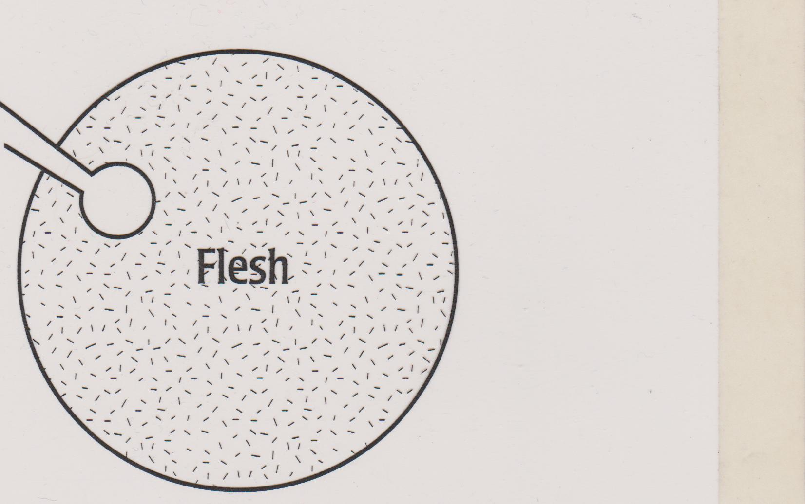
5. BAD CHOICES. FEEDING THE FLESH, STARVING THE SPIRIT
Notes:
WHAT IS THIS PERSON FEEDING? IS HE ALWAYS SEEKING HIS OWN WAY, TRYING TO GAIN ADVANTAGE OVER OTHER PEOPLE, EVEN IN BUSINESS. WHATDOES HE THINK ABOUT. HOW DOES HE SPEND HIS MONEY, WHAT’S HE LIKE WHEN NOT ONE IS LOOKING.?

Slide 26
Notes:
CHRIST DIED FOR FALLEN MAN. THE FLESH.

Slide 27
Notes:
WHICH NATURE WILL WE FEED. THE ONE WE FEED IS THE ONE THAT WILL GROW.

Slide 28
5. BAD CHOICES. FEEDING THE FLESH, STARVING THE SPIRIT
Notes:
IF THIS PERSON IS ABOUT TO MOSTLY CONTROL HIS FLESH, HIS SINFUL NATURE IN HIS OWN POWER AND SELF-CONTROL HE MIGHT LOOK LIKE A BELIEVER.

Slide 29
Notes:
REMEMBER, THERE ARE TWO JUDGEMENT SEATS. ONE FOR BELIEVERS (JUDGEMENT SEAT OF CHRIST) AND ONE FOR UNBELIEVERS (THE GREAT WHITE THRONE JUDGEMENT. BOTH BASED ON WORKS. WHAT HAVE YOU DONE WITH THE GIFTS, OPPORTUNITIES, AND RESOURCES GOD HAS ENTRUSTED TO YOU.

Slide 30
Galatians 5:16–17 (NKJV)
Walking in the Spirit
¹⁶ I say then: Walk in the Spirit, and you shall not fulfill the lust of the flesh. ¹⁷ For the flesh lusts against the Spirit, and the Spirit against the flesh; and these are contrary to one another, so that you do not do the things that you wish.
Notes:
PAUL CERTAINLY SEEMS TO THINK A BELIEVER HAS TO CHOOSE. FOLLOW THE SPIRIT OR FOLLOW THE FLESH. OUR OLD NATURE IS AT WAR WITH OUR NEW NATURE. FOCUS ON THE ROAD, NOT THE DITCH.

Slide 31
Romans 8:6-7 (NASB95)
6 For the mind set on the flesh is death, but the mind set on the Spirit is life and peace,
because the mind set on the flesh is hostile toward God; for it does not subject itself to the law of God, for it is not even able to do so,
Colossians 3:2-3 (NASB95)
2 Set your mind on the things above, not on the things that are on earth.
3 For you have died and your life is hidden with Christ in God.
Notes:
BE THE PERSON GOD SEES. HE SEES US THROUGH THE BLOOD OF CHRIST. HE SEES US SINLESS. IT WON’T BE TRUE IN PRACTICE UNTIL OUR FLESH IS DEAD.

Slide 32
1 Corinthians 3:12–15 (NKJV)
¹² Now if anyone builds on this foundation with gold, silver, precious stones, wood, hay, straw, ¹³ each one’s work will become clear; for the Day will declare it, because it will be revealed by fire; and the fire will test each one’s work, of what sort it is. ¹⁴ If anyone’s work which he has built on it endures, he will receive a reward. ¹⁵ If anyone’s work is burned, he will suffer loss; but he himself will be saved, yet so as through fire.
Notes:
IF TIME TELL STORY OF DENTAL SCHOOL AND BLOW TORCH.

Slide 33
Notes:
CHRIST DIED FOR FALLEN MAN. THE FLESH.

Slide 34
END OF FLESH VS SPIRIT MESSAGE

Slide 38
JUDGMENT OF BELIEVERS AND UNBELIEVERS
Believers Judged
Unbelievers Judged
1 Cor 3
2 Cor 5
Resurrection
Resurrection
Millennium
Israel
Church Rev. 2-3
Rapture
Tribulation Rev. 6-19
1000 Yrs
Eternity
(New Heavens & New Earth?)
Eternity
Past
GOD’S OUTLINE OF HISTORY

Slide 39
WHAT HAPPENS IF THERE IS NO MILLENNIUM?
Believers Judged
Unbelievers Judged
1 Cor 3
2 Cor 5
Resurrection
Resurrection
Millennium
Israel
Church Rev. 2-3
Rapture
Tribulation Rev. 6-19
1000 Yrs
Eternity
(New Heavens & New Earth?)
Eternity
Past
GOD’S OUTLINE OF HISTORY

Slide 40
SAME JUDGMENT SEAT FOR ALL MANKIND
Unbelievers
Great White
Throne
Believers
Resurrection
Resurrection
Rev 20
Israel
Church Rev. 2-3
Eternity
(New Heavens & New Earth?)
Eternity
Past
GOD’S OUTLINE OF HISTORY
Notes:
THERE IS A SEPARATE JUDGEMENT DAY FOR BELIEVERS

Slide 41
Notes:
SUMMARIZE. TWO COMMINGS OF CHRIST, TRUMPETS. PEACE TREATY, FALSE SAVIOUR OF ISRAEL, WORLDWIDE CATASTROPHY, MORTALS AND IMMORTALS TOGETHER DURING MESSIANIC KINGDOM, MORTALS HAVE SIN NATURE, HAVE CHILDREN WITH SIN NATURE WHO WILL EITHER ACCEPT JESUS OR REJECT HIM AND JOIN FINAL REBELLION WITH RELEASED SATAN AGAINST CHRIST. FINAL VICTORY, FINAL JUDGEMENT, AND FINAL STEP IN REDEMPTION PROGRAM (ETERNITY)

Slide 42
2 Corinthians 5:10 (ESV)
¹⁰ For we must all appear before the judgment seat of Christ, so that each one may receive what is due for what he has done in the body, whether good or evil.

Slide 43
Philippians 1:22–24 (NKJV)
²² But if I live on in the flesh, this will mean fruit from my labor; yet what I shall choose I cannot tell. ²³ For I am hard-pressed between the two, having a desire to depart and be with Christ, which is far better. ²⁴ Nevertheless to remain in the flesh is more needful for you.
Notes:
HERE PAUL USED THE WORD “FLESH” TO REFER TO HIS PHYSICAL BODY, NOT HIS SINFUL NATURE OR CARNAL FLESH AS HE HAS PREVIOUSLY.

Slide 44
Notes:
“THE OLD MAN”. INCAPABLE OF CONQUERING SIN. HE CAN DO “GOOD WORKS”. GREAT WHITE THRONE. AN UNBELIEVER’S “WORKS” DETERMINE HID DEGREE OF PUNISHMENT.

Slide 46
1 John 3:9 (NKJV)
⁹ Whoever has been born of God does not sin, for His seed remains in him; and he cannot sin, because he has been born of God.

Slide 47
Notes:
WHEN A BELIEVER SINS, WHERE IS IT’S ORIGIN? THE NEW NATURE, (CHRIST IN US THE HOPE OF GLORY ORIGINATES FROM GOD, THE SEED OF GOD. IT’S NOT THAT IT WON’T CONTINUE TO SIN, IT IS IMPOSSIBLE FOR IT TO EVER SIN.

Slide 48
DON’T CLAIM TO BE LIVING A SPIRIT FILLED OR SPIRIT CONTROLED LIFE WITH KNOWN, UNCONFESSED SIN.
DON’T CLAIM TO BE IN FELLOWSHIP WITH GOD WHEN THERE IS SIN IN YOUR LIFE THAT IS NOT BEING RECOGNIZED AND DEALT WITH.

Slide 49
REMEMBER: WE (BELIEVERS) WILL ALL STAND BEFORE THE JUDGEMENT SEAT OF CHRIST TO GIVE AN ACCOUNT OF WHAT WE HAVE DONE WITH THE GIFTS, RESOURCES, AND OPPORTUNITIES GOD HAS GIVEN US.

